Slide 1
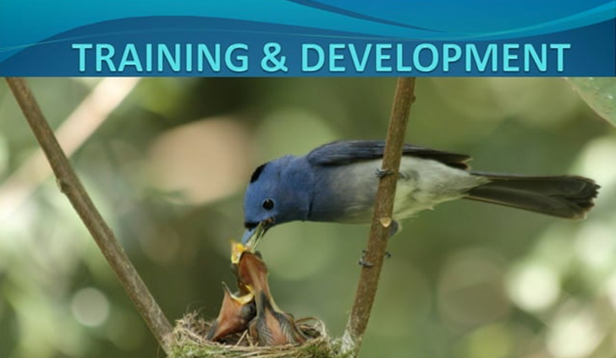

Slide 2
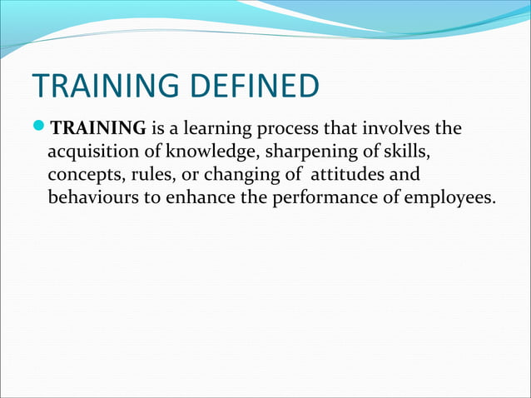

Slide 3
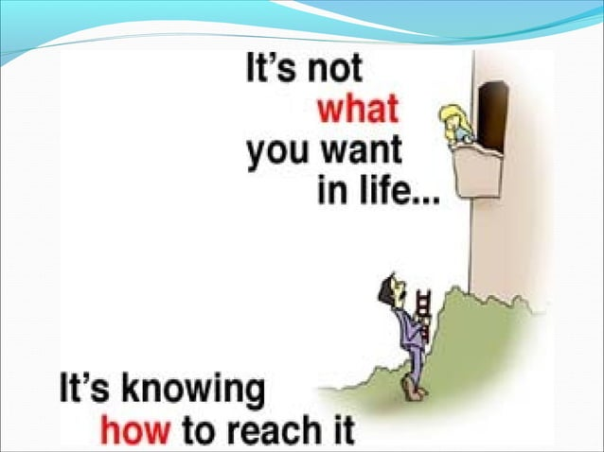

Slide 4
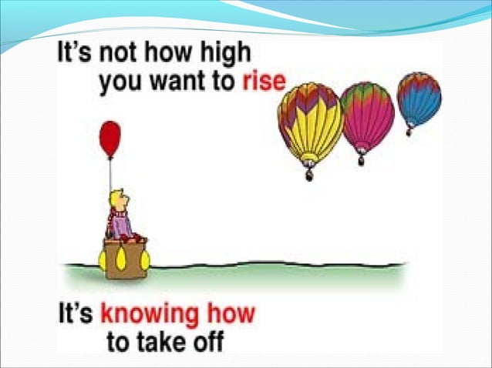

Slide 5
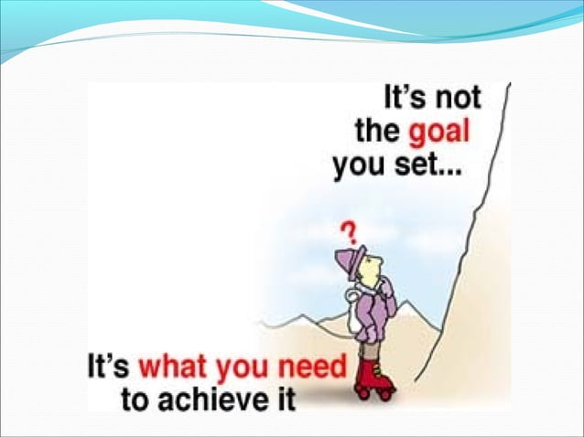

Slide 6
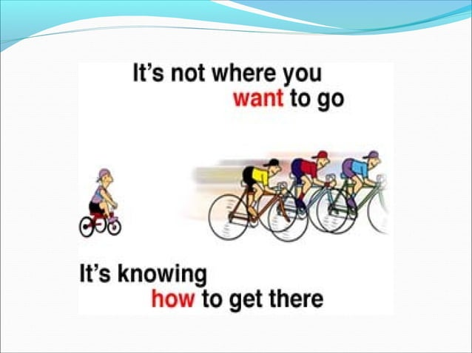

Slide 7
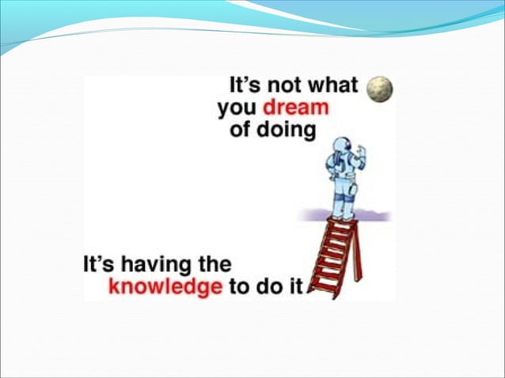

Slide 8
Definition: Development is a broader, more strategic process aimed at enhancing employees' overall capabilities and preparing them for future roles and career progression. It focuses on long-term growth and personal and professional development.

Slide 9
DIFFERENCE BETWEEN TRAINING AND DEVELOPMENT
TRAINING
DEVELOPMENT
Training is meant for operatives
It is reactive process
AIM: To develop additional skills
It is short term process
OBJECTIVE: To meet the present need of an employment
INITIATIVE is taken by the management.
Development is meant for executives.
It is pro active process
AIM: To develop the total personality
It is continuous process
OBJECTIVE: To meet the future need of an employee
Initiative is taken by an individual.

Slide 10
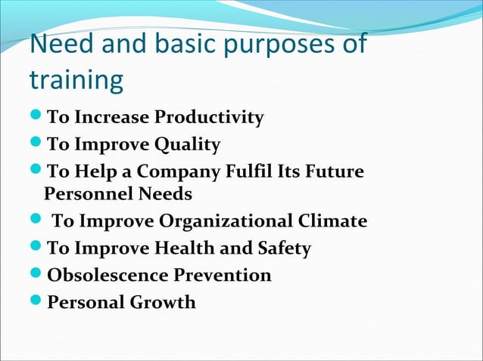

Slide 11
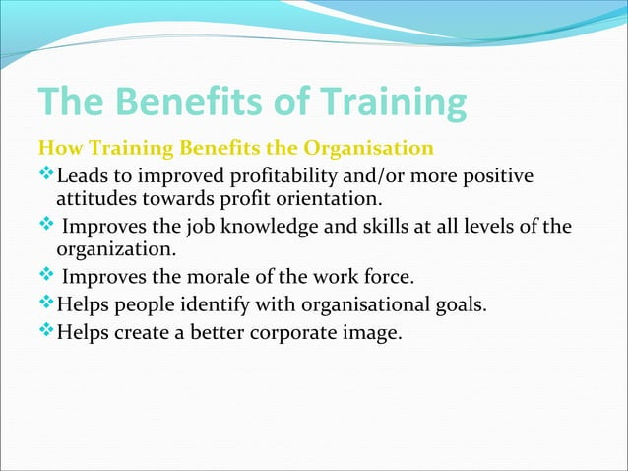

Slide 12
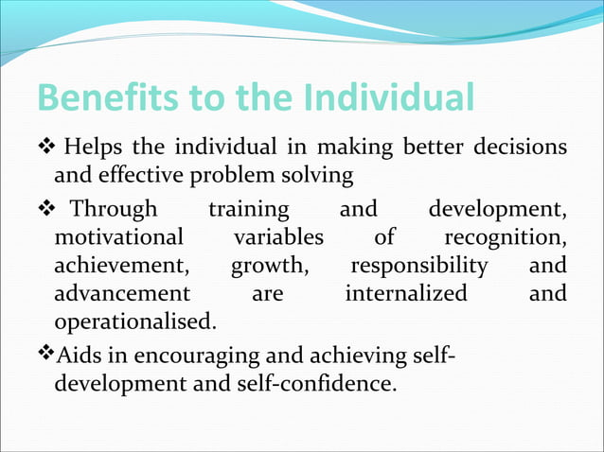

Slide 13
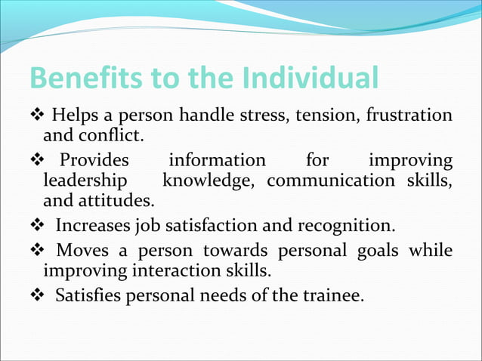

Slide 14
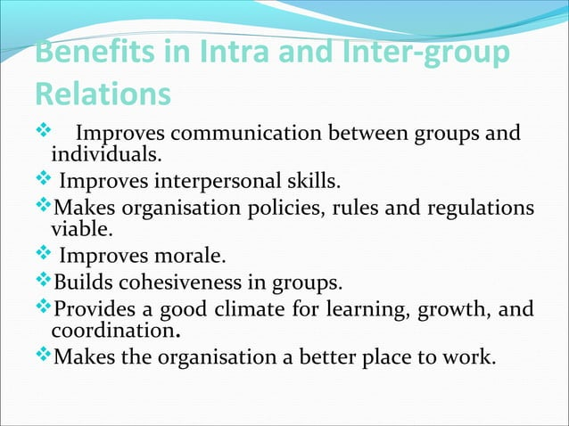

Slide 15
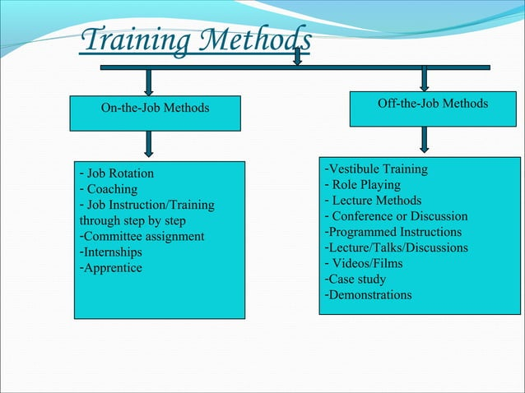

Slide 16
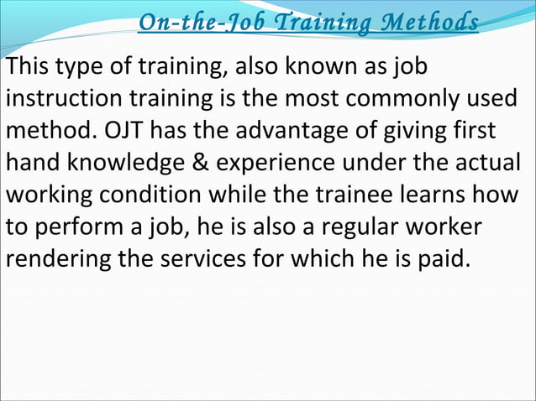

Slide 17
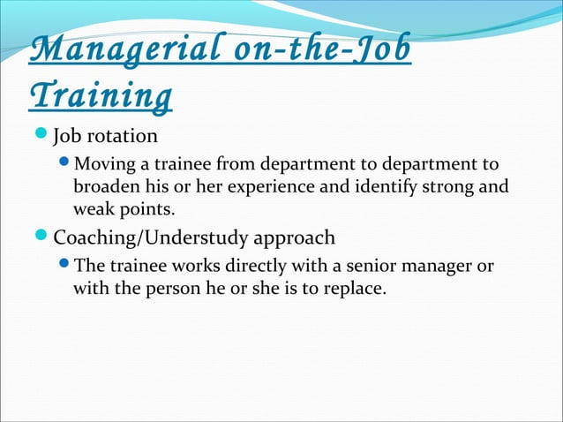

Slide 18
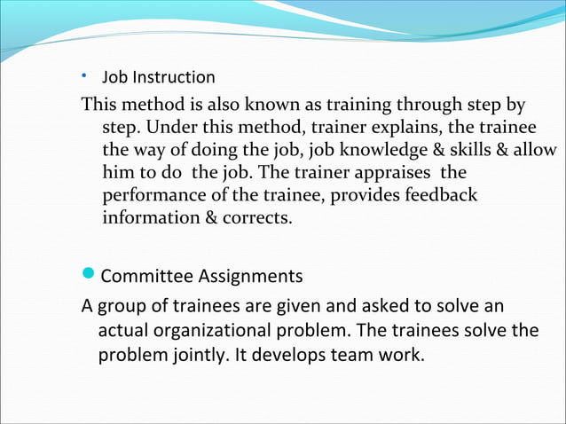

Slide 19
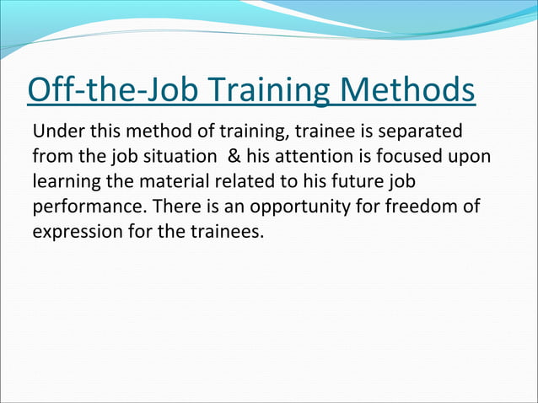

Slide 20
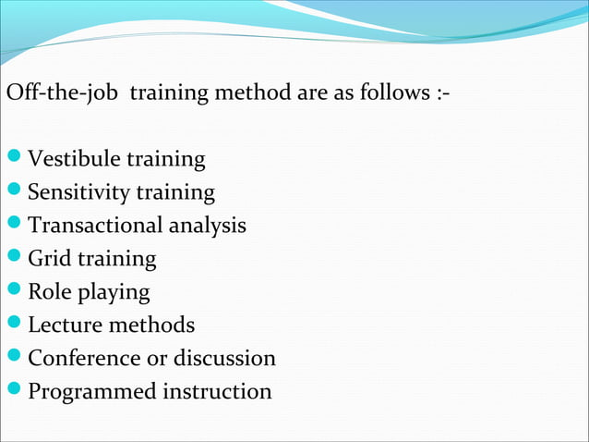

Slide 21
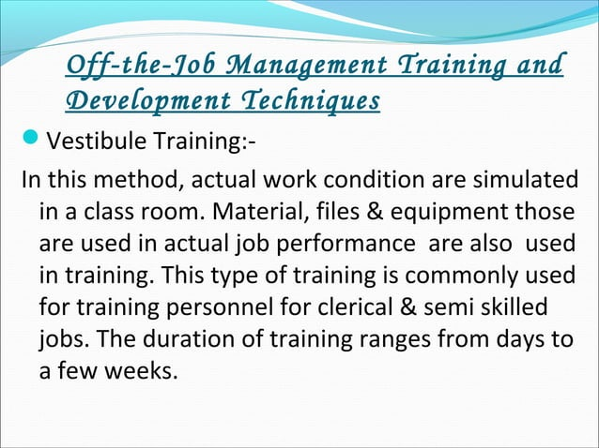

Slide 22
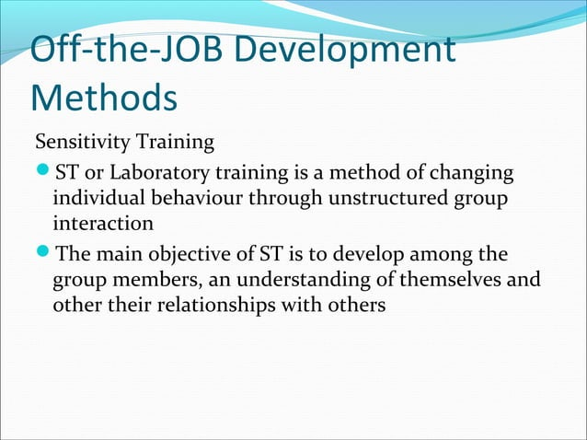

Slide 23
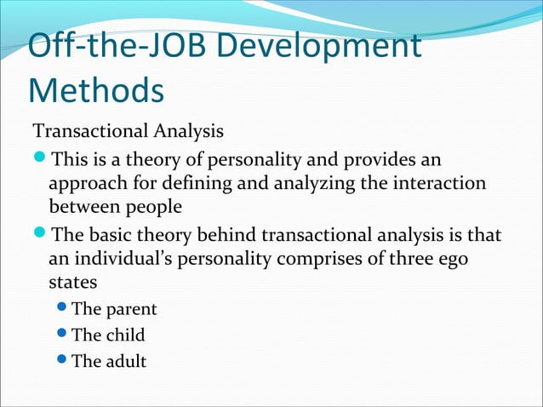

Slide 24
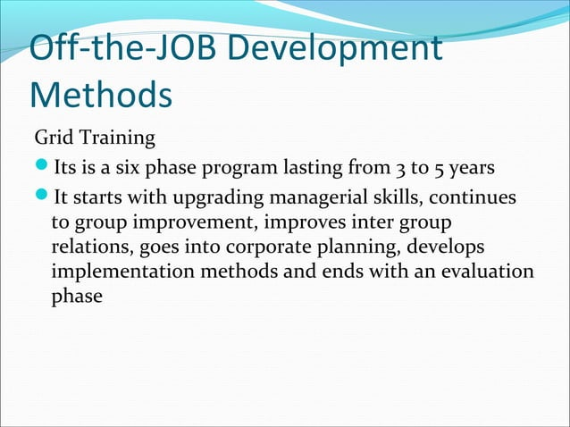

Slide 25
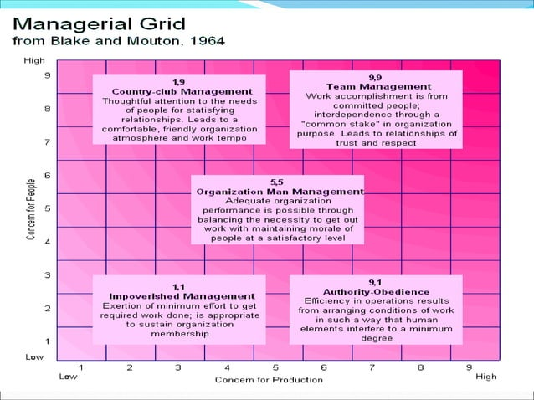

Slide 26
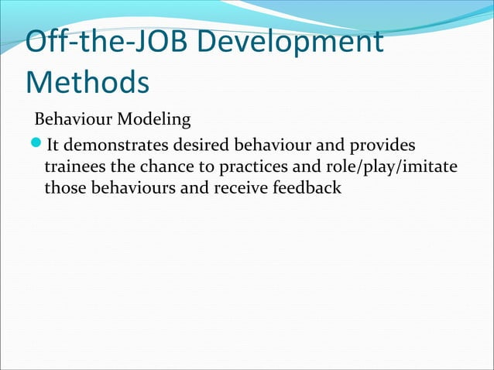

Slide 27
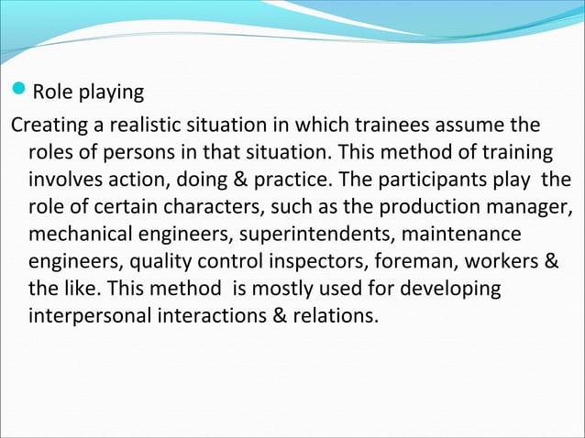

Slide 28
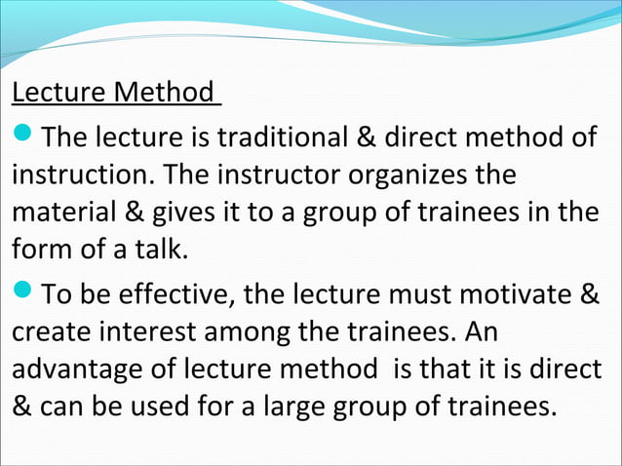

Slide 29
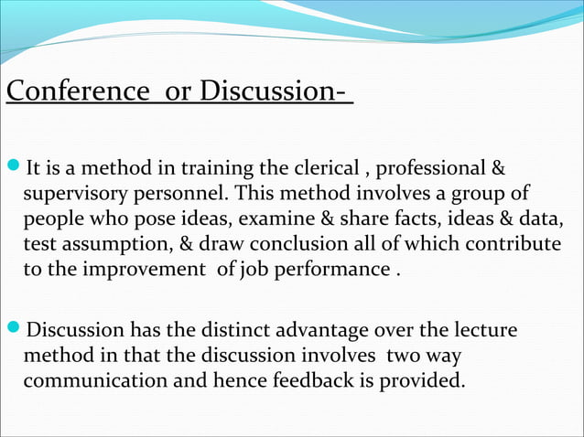

Slide 30
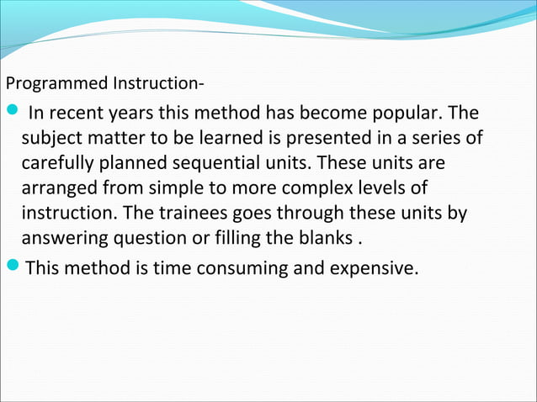

Slide 31
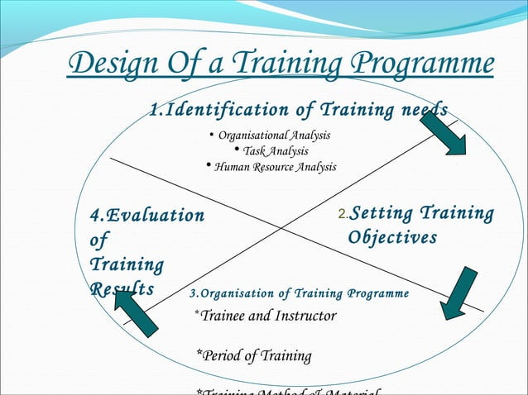

Slide 32
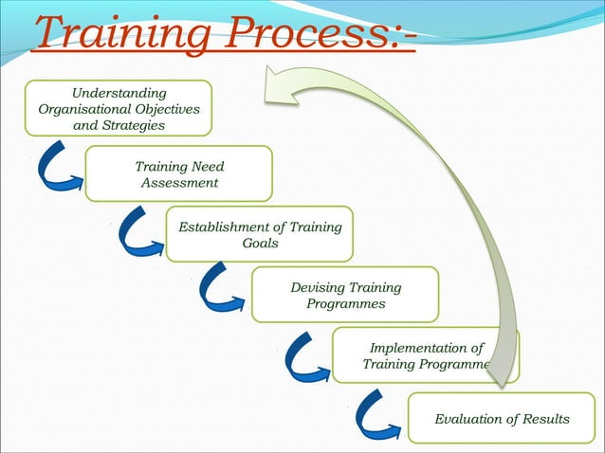

Slide 33


